Slide 1


SRI LANKA ECONOMIC
AND
INVESTMENT SUMMIT
GATEWAY TO
GROWTH
ASIA’S EMERGING
OPPORTUNITY
Shangri-La Colombo
2nd - 3rd December 2025

Slide 2



Organised by The Ceylon Chamber of Commerce
Strategic Partners:
Ministry of Foreign Affairs
Board of Investment of Sri Lanka
Sri Lanka Export Development Board
Department of Commerce Sri Lanka
Sri Lanka Convention Bureau
Asian Development Bank
World Bank Group

Slide 3
About the Summit
Objectives in brief:
  Showcase Reforms and new Growth Drivers
  Highlight Foreign Direct Investment (FDI) and Market Opportunities
  Facilitate engagement with Policymakers and Private Sector Leaders

Slide 4









Focus Sectors
Agriculture
Apparel
Export Manufacturing
Export Services
Knowledge Services
Infrastructure
Education
Power & Energy / Telecom
Tourism & Leisure
Notes:
Sector focus includes Agriculture, Apparel, Export manufacturing, knowledge services, infrastructure, Export Services, Power and Energy including telecom, Education and tourism

Slide 5
Key Features
Insights from 40+ expert resource persons
Dedicated 4 parallel Technical Sessions on:
  Ports, Logistics and Value Added Services
  Tourism
  Diversified Exports such as Value Added Agri Products, Electronics, IT, Healthcare and Fisheries
  Capital Market
Contd ….

Slide 6
Key Features ……
Networking opportunities with local and international participants
Direct engagement with key Government Officials
Explore investment opportunities :
  Urban Development Authority (UDA) Projects
  Sri Lanka Tourism Development Authority (SLTDA) initiatives
  https://sleis.chamber.lk/index.php/government-projects
  Private Sector Ventures - https://sleis.chamber.lk/index.php/private-projects
Contd ….

Slide 7
Key Features ………
Connect with Sector Hubs:
  Board of Investment of Sri Lanka (BOI)
  Inland Revenue Department (IRD)
  Sri Lanka Customs
  Urban Development Authority (UDA)
  Sri Lanka Export Development Board (EDB)
Post event Tours

Slide 8

Facilities on offer for foreign delegates
Discounted Airfare from the National Carrier SriLankan Airlines
Post Event Tours 4th Dec. - Port City Colombo or Export Processing Zone
Group of 10 or more - Leader or the Co-ordinator of the delegation
  FOC Registration for the Summit
  Three nights hotel accommodation with Bed and Breakfast
  Airport transfer to Hotel

Slide 9

Promotion of the Summit
Diplomatic Missions in Sri Lanka
Sri Lanka Diplomatic Missions overseas
132 MOU Partner Chambers overseas in 65 countries
Social Media Platforms
Electronic and Print Media
Summit Brochure available in 10 languages

Slide 10
Summit Web

Slide 11
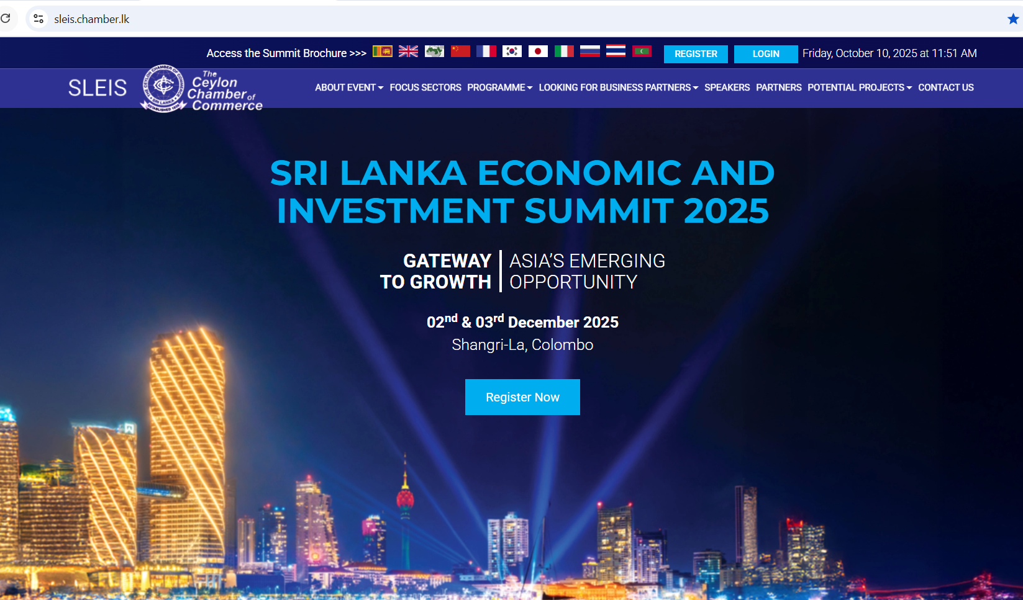

Slide 12



Features of the Summit Web
📝 Online Registration & Payments
🏨 Hotel Accommodation Reservations
🚖 Airport Transfer Requests
Pre-scheduled B2B & G2B Meetings
🛂 Letter of Invitation for Visa
Post-Event Tour Registration

Slide 13
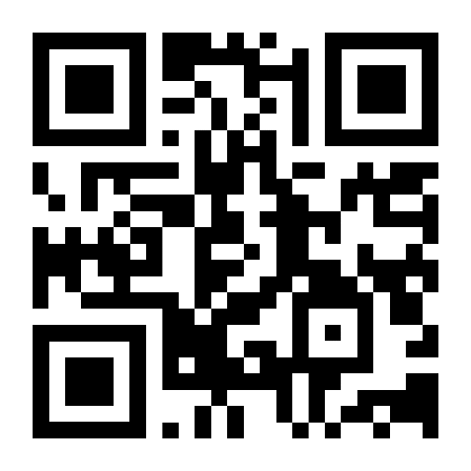
How to Register
https://sleis.chamber.lk

Slide 14

3rd December – Investment Session
Notes:
Invitations will be extended to Heads of Missions to join us on 3rd December 2025 inauguration of the Investment Sessions

Slide 15
Thank You
https://sleis.chamber.lk
E-mail: sles@chamber.lk

